Slide 1
360 Degree feedback software for the government of India related News Stories in Regional Media using Artificial Intelligence/Machine learning – PSCS_35
CSE7101- Capstone Project
Review-2
Batch Number: COM_02
Under the Supervision of,
Dr. Pallavi M
Assistant Professor
School of Computer Science and Engineering
Presidency University
20221COM0049 | Thakkola Suprathika
20221COM0022 | Yerramsetty Poojitha
20221COM0048 | Siva Bhaskar Kora
Roll Number | Student Name
Name of the Program: COM
Name of the HoD: Dr. Pallavi R
Name of the Program Project Coordinator: Ms. Benitha Christinal J
Name of the School Project Coordinators: Dr. Sampath A K , Dr. Geetha A

Slide 2
Content
Abstract
Problem Statement
Objectives
Literature Survey
Proposed Methodology
Architecture Diagram
Modules
Implementation Progress

Slide 3
Content
Hardware & Software Requirements
Timeline (Gantt Chart)
Innovation / Novel Contributions
SDG Mapping
Future Directions
References

Slide 4
Abstract
The project introduces a centralized Government Sentiment Hub that extracts text from regional news using OCR, performs sentiment analysis, and automatically routes the information to the relevant government department. This system enhances grievance handling with improved efficiency, transparency, and real-time monitoring, thereby strengthening the accuracy and responsiveness of e-governance[1], [2].
Additionally, the platform provides a dashboard for administrators to track department-wise issues, sentiment trends, and action requirements. By converting unstructured media news into actionable insights, the proposed system supports faster decision-making and promotes more accountable governance[6].

Slide 5
Problem Statement
Current system: Manual/semi-automated verification of regional news → delayed response to citizen issues.
Challenges: Handles neither multilingual content nor image-based news; lacks real-time dashboards; high workload due to large volume of sources; no automatic routing to concerned departments.
Goal: Automate text extraction, sentiment analysis, and routing to ensure faster, accurate, and actionable government response.

Slide 6
Objectives
Extract text accurately from regional news images using OCR.
Analyze sentiment (Positive/Negative/Neutral) of the extracted content.
Automatically classify and route issues to the relevant government department.
Provide real-time dashboards for administrative monitoring and decision-making.
Improve grievance response speed, transparency, and accountability in e-governance.

Slide 7
Literature Survey
Reviewed 20 research papers covering OCR, sentiment analysis, multilingual processing, and automated classification for e-governance.
Sl. No | Authors & Reference Title | Year | Benefits | Limitations
1 | Corallo A. et al., “Sentiment Analysis for Government: An Optimized Approach” | 2015 | Sentiment analysis applied for policy feedback | Only handles English; no routing to Govt. departments
2 | Leelavathy S., Nithya M., “Public Opinion Mining in Smart Cities” | 2020 | Analyzes citizen feedback for smart governance | Cannot extract text from images or multilingual content
3 | Vila M. et al., “Government Data Dashboard for Policy Visualization” | 2018 | Provides real-time dashboard insights for administrators | No NLP or sentiment support
4 | Aubaid A. H., “Rule-Based Text Classification Using Linguistic Patterns” | 2020 | Lightweight classification for government topics | Rules break in ambiguous language

Slide 8
5 | Kalpana S., Suman R., “Keyword Enhanced Classification for Imbalanced Datasets” | 2023 | Improves accuracy for multi-topic classification | Slow in deployment; complex tuning
6 | Agüero-Torales M. M. et al., “Multilingual Sentiment Analysis using Deep Learning” | 2021 | Strong support for multilingual datasets | Heavy GPU & high training cost
7 | Kumar A. et al., “Performance Improvement in OCR using Pytesseract” | 2024 | Good accuracy for clear captured images | Accuracy drops with noisy screenshots
8 | Neudecker C. et al., “OCR Evaluation Techniques for Text Extraction” | 2021 | Helps measure efficiency in image-based text extraction | No end-to-end automation
9 | Massonet P. et al., “Secured Audit Logging Architecture in Enterprises” | 2011 | Ensures secure data logs for Govt. apps | No classification/sentiment support
10 | Gomaa M., “Multilingual Challenges in E-Governance Platforms” | 2021 | Identifies need for language inclusivity | No automated sentiment & routing

Slide 9
Proposed Methodology
The Government Sentiment Hub follows a structured multi-layer pipeline to
automate the analysis and routing of regional news.
Layers in the System
Input Layer
Text or uploaded screenshots
API-based input integration
Pre-Processing Module
OCR using Pytesseract[15]
Noise removal, tokenization, stop word filtering[12]
Department Classification
Keyword mapping using departments.json
Multi-label routing to appropriate departments[19]

Slide 10
Proposed Methodology
4. Verification & Logging Layer
Admin review interface
Secure verification logs with audit trail[16]
5. Output Layer
Department-wise reports
Sentiment analytics dashboard and charts[6]

Slide 11
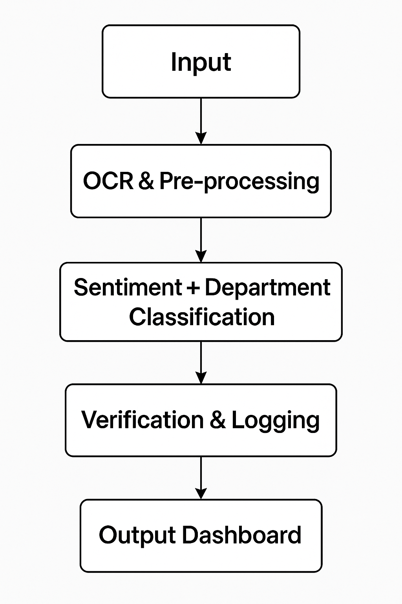
Proposed Methodology
Flowchart

Slide 12
System Architecture
The system follows a 3-layer client–server architecture integrating OCR, NLP and classification modules with secure data logging and admin dashboards.
1. Client Layer
Web browser interface (Verify Input Page)
Admin dashboard for visualization[6]
2. Application Layer (Flask Server)
Input Handler Module
OCR Engine (Pytesseract)[15]
Text Pre-processing Module[12]
Sentiment Analysis (TextBlob)[18]
Department Classification Engine (Keyword Mapping)[19]
Verification Logging API[16]

Slide 13
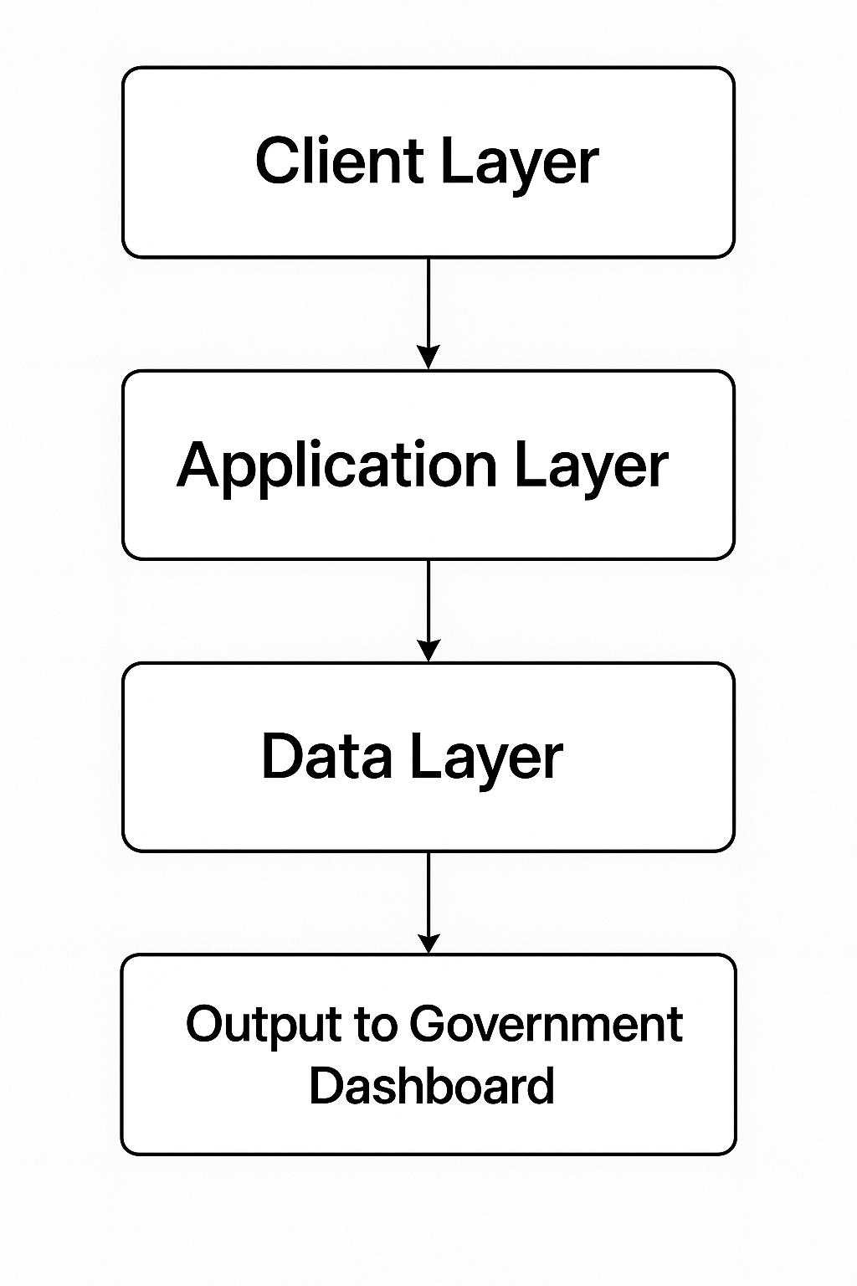
System Architecture
3. Data Layer
Verification log storage (JSON/DB)[16]
departments.json keyword repository[19]
Analytics data for dashboards[6]
System Data Flow

Slide 14
Modules
Data Input: Text or image upload through web interface.
OCR & Pre-processing: Extract text, cleaning, tokenization[12], [15].
Sentiment Analysis: Classify content as Positive / Negative / Neutral[18].
Department Mapping: Route issues to respective departments[19].
Logging: Store feedback with timestamp and status[16].
Dashboard Reporting: Visual charts and department-wise statistics[6].

Slide 15
Implementation Progress
All Components Fully Implemented and Tested
OCR Module (Pytesseract) integrated for extracting text from news images[15]
Text Pre-processing (Cleaning, Normalization, Tokenization)[12]
Sentiment Analysis (Positive / Negative / Neutral using TextBlob)[18]
Department Classification using keyword-based mapping (departments.json)[19]
Verification Log with timestamp, sentiment, and assigned department[16]
Admin Dashboard with:
Sentiment statistics graph (Chart.js)[6]
Department-wise analytics & latest post summaries[6]
Web Interface developed using Flask for both user upload and admin access[10]
Multi-modal Input Support (Text and Image)

Slide 16
Hardware & Software Requirements
Software Requirements:
Python (Flask Framework)
Pytesseract – OCR Integration
TextBlob – Sentiment Analysis
HTML, CSS, JavaScript — Frontend
Chart.js — Data Visualization
JSON — Department Routing Dataset
VS Code / PyCharm — Code Development
GitHub — Version Control

Slide 17
Hardware & Software Requirements
Hardware Requirements:
Category | Requirement
Processor | Minimum: Dual Core
RAM | Minimum: 8 GB
Storage | 256 GB (Recommended SSD)
Network | Stable Internet During Deployment
Optional | GPU support if deep learning integration in future

Slide 18
Results & Performance Analysis
OCR Accuracy Improvement
Without Pre-processing → 87.6%
With Pre-processing → 95.1%
+7.5% increase in Word Accuracy[13]
Sentiment Classification Performance
Sentiment | Precision | Recall | F1-Score
Positive | 91.2% | 94.0% | 0.926
Negative | 93.5% | 90.9% | 0.922
Neutral | 85.7% | 86.8% | 0.862

Slide 19
Results & Performance Analysis
Average F1 = ~0.90[18], [14]
High performance in Positive & Negative classes enables faster action decisions.
3. Department Routing Accuracy
90% accurate multi-label routing across 12+ departments[19]
Reliable for real-time e-governance categorization
Strong performance even with overlapping department keywords
4. Dashboard & UI Validation
Real-time verification and visualization confirmed using:
OCR + Sentiment + Routing on uploaded images[6]
Department Dashboard
Statistical charts[6]

Slide 20
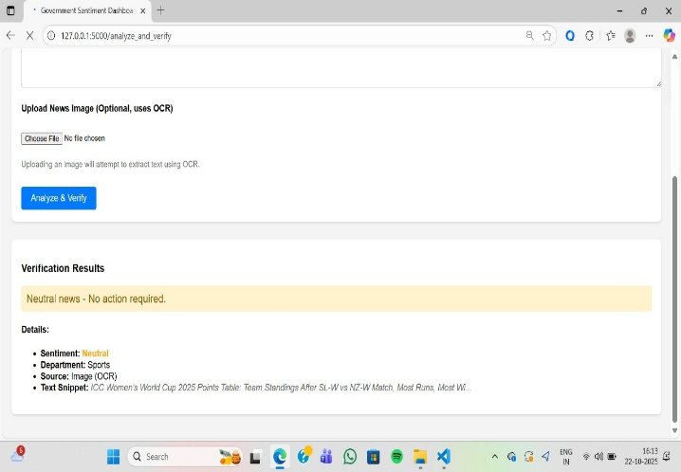
Results & Performance Analysis
Verification Page Output

Slide 21
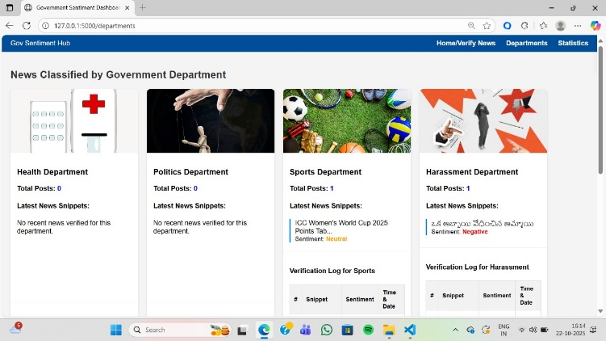
Results & Performance Analysis
Department Dashboard View

Slide 22
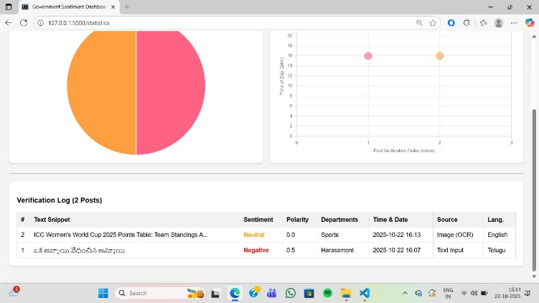
Results & Performance Analysis
Sentiment Stats Dashboard

Slide 23
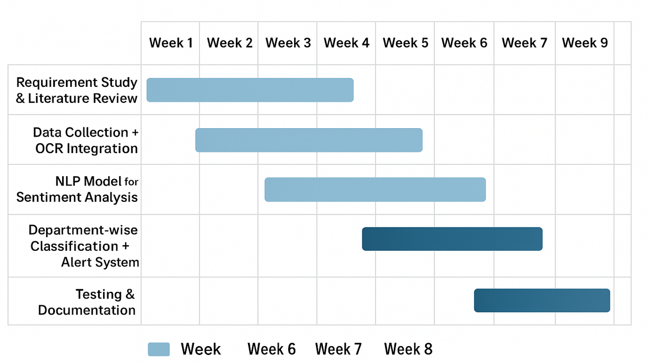
Timeline (Gantt Chart)

Slide 24
Innovation / Novel Contributions
End-to-end automated sentiment governance system integrating OCR + sentiment analysis + classification in a single platform[1], [2]
Department-wise routing enables policy-level insights and faster action by concerned authorities[4], [6]
Real-time negative sentiment alerts support urgent response to critical public issues[4]
Multilingual capability design for handling diverse regional news content across India[14]
Dashboards with workload visualization for government decision-making and transparency improvements[6]

Slide 25
SDG Mapping
This project contributes to the United Nations Sustainable Development Goals by improving digital governance, enhancing institutional efficiency, and enabling transparent citizen service delivery.
SDG | Goal Focus | Project Contribution
SDG 9 – Industry, Innovation & Infrastructure | Promote innovative digital governance | AI-driven automation of news verification and department routing improves government infrastructure efficiency
SDG 16 – Peace, Justice & Strong Institutions | Enhance transparency & accountability in public services | System enables faster action on citizen issues, verification logs, and fair governance support

Slide 26
Future Directions
Multilingual NLP expansion to support major Indian regional languages for wider accessibility[14]
Advanced transformer-based models (BERT/mBERT) for improved sentiment accuracy and sarcasm handling[14]
Real-time alert notifications to concerned departments for high-risk or negative news[4]
Automated dataset enrichment using keyword extraction and topic modeling[19]
Government API integration for automated grievance ticket generation
Scalable cloud deployment enabling national-level adoption and continuous monitoring
Mobile interface for faster field reporting and verification

Slide 27
References
[1] A. Corallo et al., "Sentiment Analysis for Government: An Optimized Approach," in Machine Learning and Data Mining in Pattern Recognition. MLDM 2015. Lecture Notes in Computer Science, P. Perner, Ed. Cham: Springer, 2015, vol. 9166, pp. 79–90. doi: 10.1007/978-3-319-21024-7_7.
[2] S. Leelavathy and M. Nithya, "Public opinion mining using natural language processing technique for improvisation towards smart city," Int. J. Speech Technol., vol. 23, pp. 83–91, Nov. 2020. doi: 10.1007/s10772-020-09766-z.
[3] J. W. Creswell and J. D. Creswell, "Research Design: Qualitative, Quantitative, and Mixed Methods Approaches, 5th Edition," J. Educ. Meas., vol. 59, no. 2, pp. 248–251, 2022. doi: 10.1080/15424065.2022.2046231.
[4] W. Kimberlee et al., "Automated decision-making in NSW: Mapping and analysis of the use of ADM systems by state and local governments," Aust. J. Public Adm., vol. 83, no. 1, pp. 49–67, Mar. 2024. doi: 10.60836/40eb-we52.
[5] G. Chandrasekaran and J. Hemanth, "Deep Learning and TextBlob Based Sentiment Analysis for Coronavirus (COVID-19) Using Twitter Data," Int. J. Artif. Intell. Tools, vol. 31, no. 1, p. 2250011, 2022. doi: 10.1142/S0218213022500117.

Slide 28
References
[6] R. A. Vila, E. Estevez, and P. R. Fillottrani, "The design and use of dashboards for driving decision-making in the public sector," in Proc. 19th Annu. Int. Conf. Digit. Gov. Res., New York, NY, USA: ACM, 2018, pp. 31–40. doi: 10.1145/3209415.3209467.
[7] J. H. Ward, Jr., and P. R. Sarle, "Algorithms for Clustering Data," Technometrics, vol. 32, no. 2, pp. 227–229, 1990. doi: 10.1080/00401706.1990.10484648.
[8] T. Joachims, "Text categorization by machine learning," ACM Comput. Surv., vol. 34, no. 2, pp. 164–197, Jun. 2002. doi: 10.1145/508445.508447.
[9] A. M. Aubaid, "A Rule-Based Approach to Embedding Techniques for Text Document Classification," Appl. Sci., vol. 10, no. 11, p. 4009, 2020. doi: 10.3390/app10114009.
[10] U. Patkar et al., "PYTHON FOR WEB DEVELOPMENT," Int. J. Comput. Sci. Manag. Stud., vol. 11, no. 4, pp. 36–48, Apr. 2022. doi: 10.47760/ijcsmc.2022.v11i04.006.
[11] K. Adnan and R. Akbar, "Limitations of information extraction methods and techniques for heterogeneous unstructured big data," Inf. Technol. Control, vol. 49, no. 1, pp. 153–166, 2020. doi: 10.1177/1847979019890117.

Slide 29
References
[12] J. Kaur and P. K. Buttar, "STOPWORDS REMOVAL AND ITS ALGORITHMS BASED ON DIFFERENT METHODS," Int. J. Adv. Res. Comput. Sci., vol. 9, no. 5, pp. 81–86, Sep./Oct. 2018. doi: 10.26483/ijarcs.v9i5.6301.
[13] C. Neudecker et al., "A survey of OCR evaluation tools and metrics," in Proc. 2021 ACM Symp. Document Eng. (DocEng '21), New York, NY, USA: ACM, 2021, pp. 147–156. doi: 10.1145/3476887.3476888.
[14] M. M. Agüero-Torales, J. I. A. Salas, and A. G. López-Herrera, "Deep learning and multilingual sentiment analysis on social media data: An overview," Appl. Soft Comput., vol. 109, p. 107373, Sep. 2021. doi: 10.1016/j.asoc.2021.107373.
[15] S. Kumar et al., "Text Extraction from Images Using Tesseract," in Innovations in Computational Intelligence and Data Sciences, P. S. Rathore et al., Eds. Hoboken, NJ, USA: Wiley, 2024, pp. 1–18. doi: 10.1002/9781394234271.ch1.

Slide 30
References
[16] P. Massonet et al., "A Monitoring and Audit Logging Architecture for Data Location Compliance in Federated Cloud Infrastructures," in 2011 IEEE Int. Symp. Parallel Distrib. Process. Workshops PhD Forum, Anchorage, AK, USA, 2011, pp. 1510–1517. doi: 10.1109/IPDPS.2011.304.
[17] S. Loria, Pytesseract (Version 5.0.0-alpha.2) [Software]. 2023. Available: https://pypi.org/project/pytesseract/.
[18] S. Loria, TextBlob (Version 0.17.1) [Software]. 2018. Available: https://textblob.readthedocs.io/en/dev/.
[19] T. M. Kalpana and M. Suman, "Leveraging Keyword-Enhanced Models to Handle Class Imbalance in Text Classification," in Proc. 2023 Conf. Empir. Methods Nat. Lang. Process. (EMNLP), 2023, pp. 2023–2035. Available: https://pmc.ncbi.nlm.nih.gov/articles/PMC9533247/.
[20] Y. A. Gomaa, "Language policy in the virtual linguistic landscape: The case of the Kingdom of Bahrain E-Government national portal," Linguagem em (Dis)curso, vol. 21, no. 2, pp. 375–395, 2021. doi: 10.26512/les.v21i2.29354.

Slide 31


